Slide 1
Quantum Squeeze-and-Excitation Networks
Yifeng Peng (PhD candidate)
Advisor: Ying Wang
Stevens Institute of Technology

Slide 2
Background
Traditional CNN may ignore key information in images or be too sensitive to background noise when processing visual tasks. Recently, incorporating attention mechanisms into CNNs has emerged as a potent approach. Attention Networks, inspired by the attributes of human visual attention, enable the network to focus more acutely on salient image regions, thereby enhancing the model's expressiveness and overall performance. Such methods have yielded impressive outcomes across a spectrum of computer vision applications, including image classification, object detection, and semantic segmentation.
Classical SE-ResNet (Squeeze-and-Excitation ResNet) is a convolutional neural network architecture combined with the Squeeze-and-Excitation (SE) module [1]. The SE module improves the network's representation ability by recalibrating feature responses. Although the SE module has achieved remarkable results in enhancing network performance, it also has some limitations. The SE module recalibrates the channels of the feature map by adding additional fully connected layers to the network. This means that for each SE module, a certain amount of parameters and computational complexity will be added. In large networks or resource-constrained environments, this can become a problem. The fully connected layer plus ReLU may limit the ability to model complex channel interactions. The linear and non-negative properties of ReLU may not be sufficient to capture complex inter-channel dependencies.
[1] J. Hu, L. Shen, S. Albanie, G. Sun, and E. Wu, “Squeeze-and-excitation networks,” 2018 IEEE/CVF Conference on Computer Vision and Pattern Recognition, pp. 7132–7141, 2017. [Online]. Available: https://api.semanticscholar.org/CorpusID:140309863

Slide 3
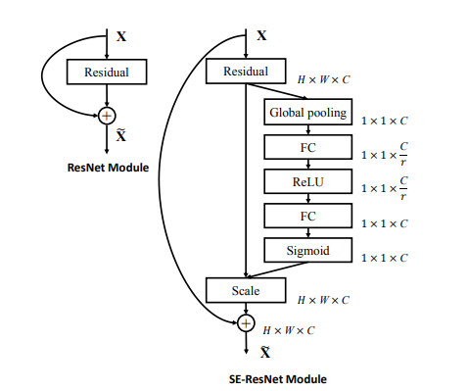
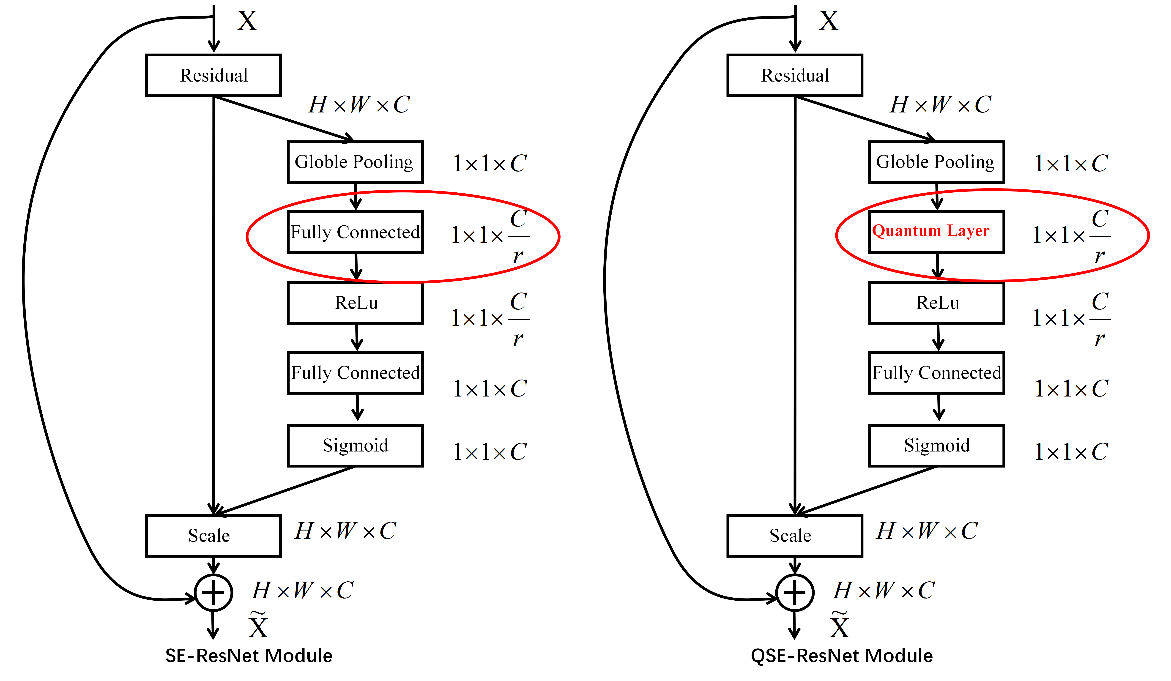
Methodology
J. Hu, L. Shen, S. Albanie, G. Sun, and E. Wu, “Squeeze-and-excitation networks,” 2018 IEEE/CVF Conference on Computer Vision and Pattern Recognition, pp. 7132–7141, 2017. [Online]. Available: https://api.semanticscholar.org/CorpusID:140309863

Slide 4
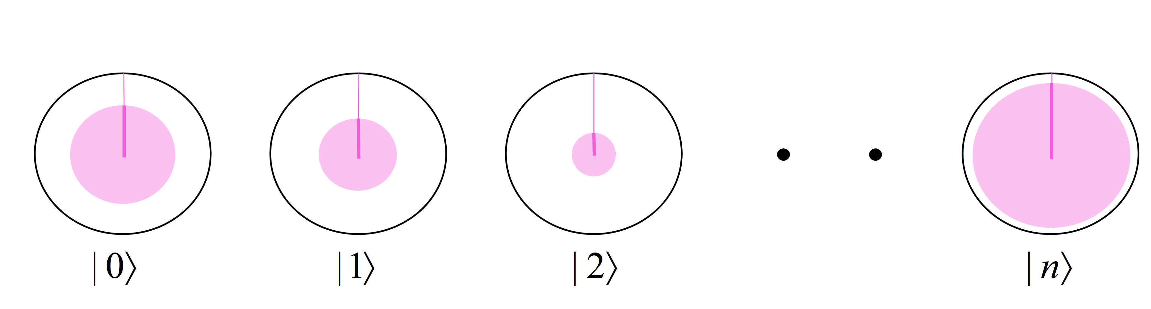
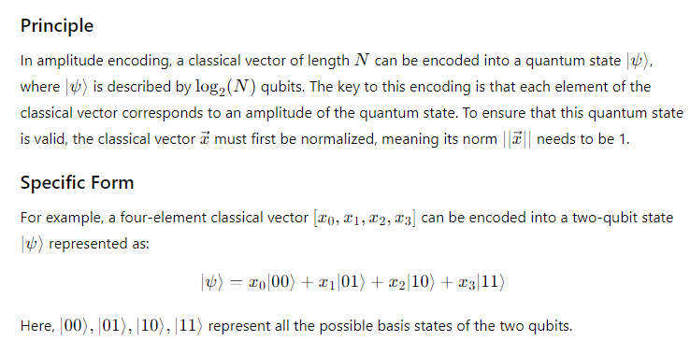
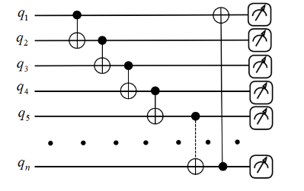
Methodology
Amplitude Embedding
Quantum circuit for the QSE module

Slide 5
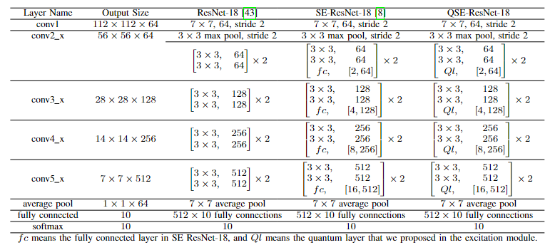
Experimental Results

Slide 6
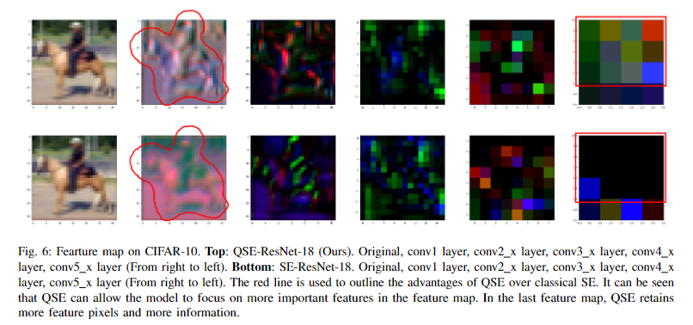
Experimental Results

Slide 7
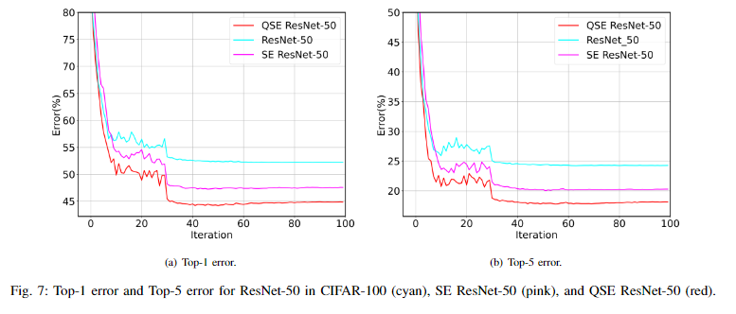
Experimental Results

Slide 8
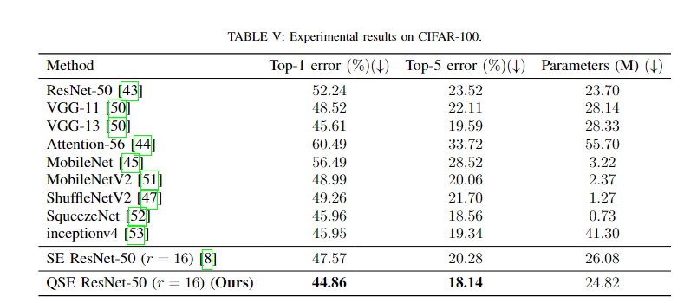
Experimental Results

Slide 9
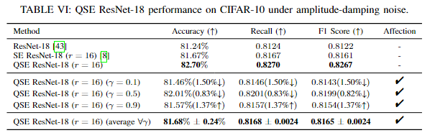
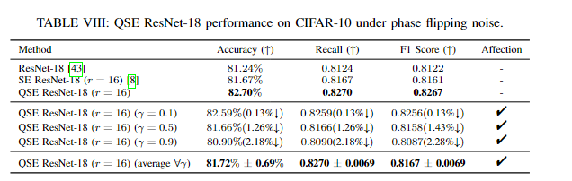
Experimental Results - Noise Analysis

Slide 10
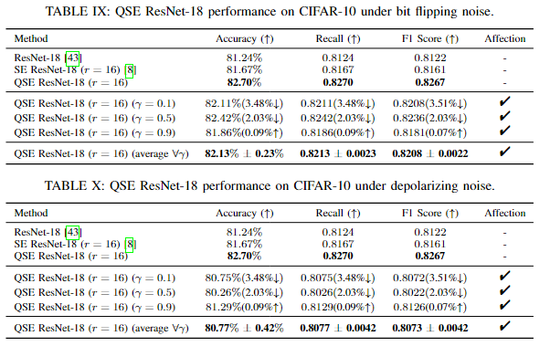
Experimental Results - Noise Analysis

Slide 11
Conclusion and Future Work
We proposed a novel QSE network, an advanced iteration of the classic Squeeze and Excitation network. This model leverages quantum computing principles, particularly quantum amplitude coding, to revamp the excitation function. Notably, it optimizes the network by reducing the parameter count while enhancing accuracy metrics on benchmark datasets like CIFAR-10 and decreasing top-1 and top-5 error rates on CIFAR-100. In the NISQ era, our QSE network's architectural efficiency, characterized by its minimalistic use of qubits and quantum gates, inherently mitigates noise, thereby fortifying its lower noise threshold. In the future, we plan to verify and further improve the QSE module on a real quantum computer.

